Slide 1
Day 9
Inverse Kinematics; Trajectory Generation

Slide 2
Spherical Wrist
o_{c}
o
d₆

Slide 3
Inverse Kinematics Recap
Solve for the first 3 joint variables q₁, q₂, q₃ such that the wrist center o_{c} has coordinates
Using the results from Step 1, compute
Solve for the wrist joint variables q₄, q₅, q₆ corresponding to the rotation matrix

Slide 4
Spherical Wrist
for the spherical wrist

Slide 5
Spherical Wrist

Slide 6
Spherical Wrist

Slide 7
Spherical Wrist
if θ₅ = 0

Slide 8
Spherical Wrist
continued from previous slide
only the sum θ₄+θ₆
can be determined

Slide 9
Using Inverse Kinematics in Path Generation

Slide 10
Path Generation
a path is defined as a sequence of configurations a robot makes to go from one place to another
a trajectory is a path where the velocity and acceleration along the path also matter

Slide 11
Path Generation
consider the 2-link RR robot
a₂
θ₂
a₁
θ₁

Slide 12
Path Generation
suppose that the
initial configuration $θ_{1}=45$ and $θ_{2}=−180$
final configuration $θ_{1}=270$ and $θ_{2}=90$

Slide 13
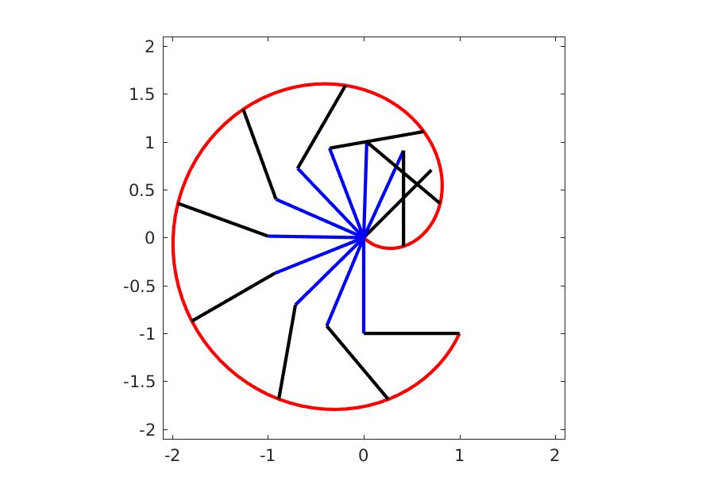
Joint-Space Path
a joint-space path is computed considering the joint variables
link 1
link 2
end effector path

Slide 14
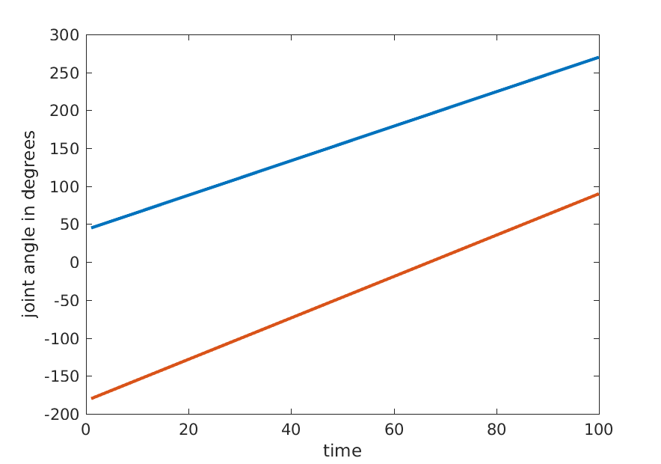
Joint-Space Path Joint Angles
linear joint-space path
link 1
link 2

Slide 15
Joint-Space Path
given the current end-effector pose and the desired final end-effector pose find a sequence of joint angles that generates the path between the two poses
idea
solve for the inverse kinematics for the current and final pose to get the joint angles for the current and final pose
interpolate the joint angles

Slide 16
Joint-Space Path
⇒ inverse kinematics ⇒
⇒ inverse kinematics ⇒

Slide 17
Joint-Space Path
find ⁰Q from ⁰T (inverse kinematics)
find ^{f}Q from ^{f}T (inverse kinematics)
Δ t = 1 / m where m is the number of steps in the path
ΔQ = ^{f}Q – ⁰Q
for j = 1 to m
t_{j} = j Δ t
^{j}Q = ⁰Q + t_{j} Δ Q
set joints to ^{j}Q
end

Slide 18
Joint-Space Path
linearly interpolating the joint variables produces
a linear joint-space path
a non-linear Cartesian path
depending on the kinematic structure the Cartesian path can be very complicated
some applications might benefit from a simple, or well defined, Cartesian path
e.g., move in a straight line, trace the shape of an object, move around objects in the workspace

Slide 19
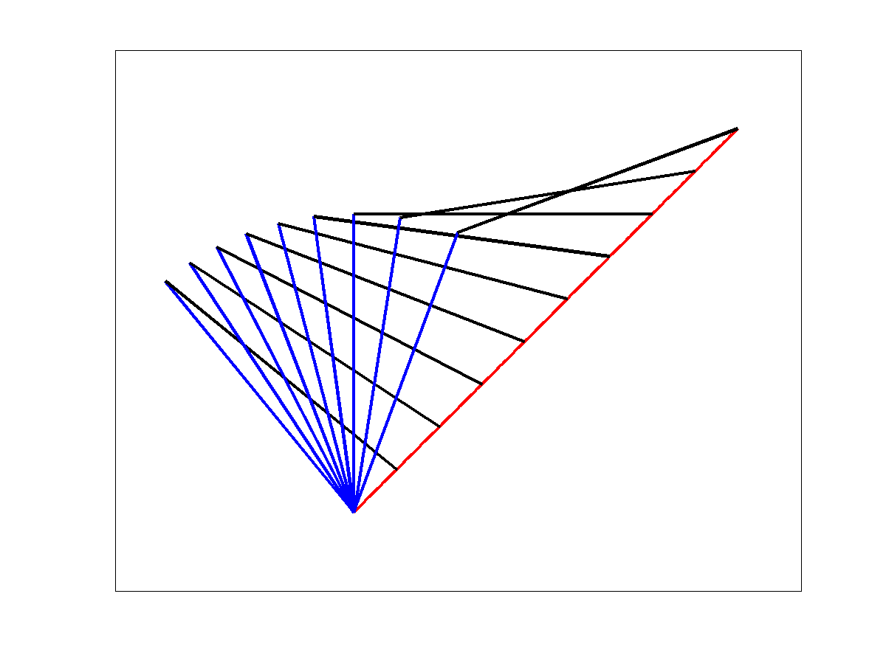
Cartesian-Space Path
a Cartesian-space path considers the position of end-effector
link 2
end effector path
link 1

Slide 20
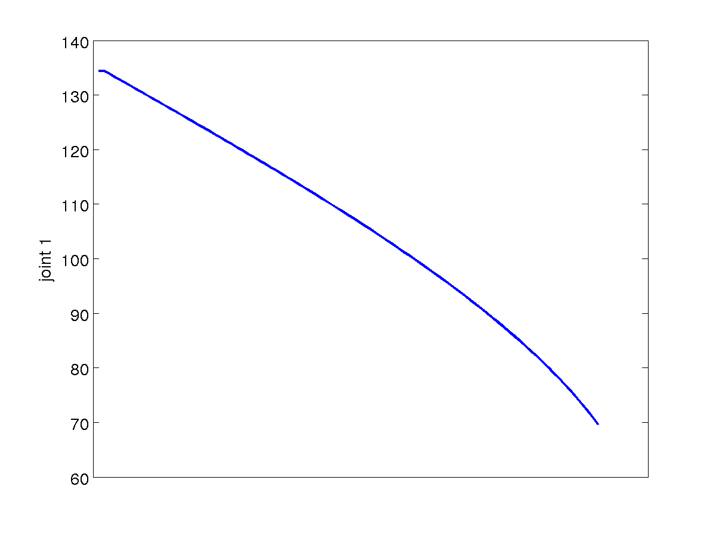
Cartesian-Space Path Joint Variable 1
non-linear joint-space path

Slide 21
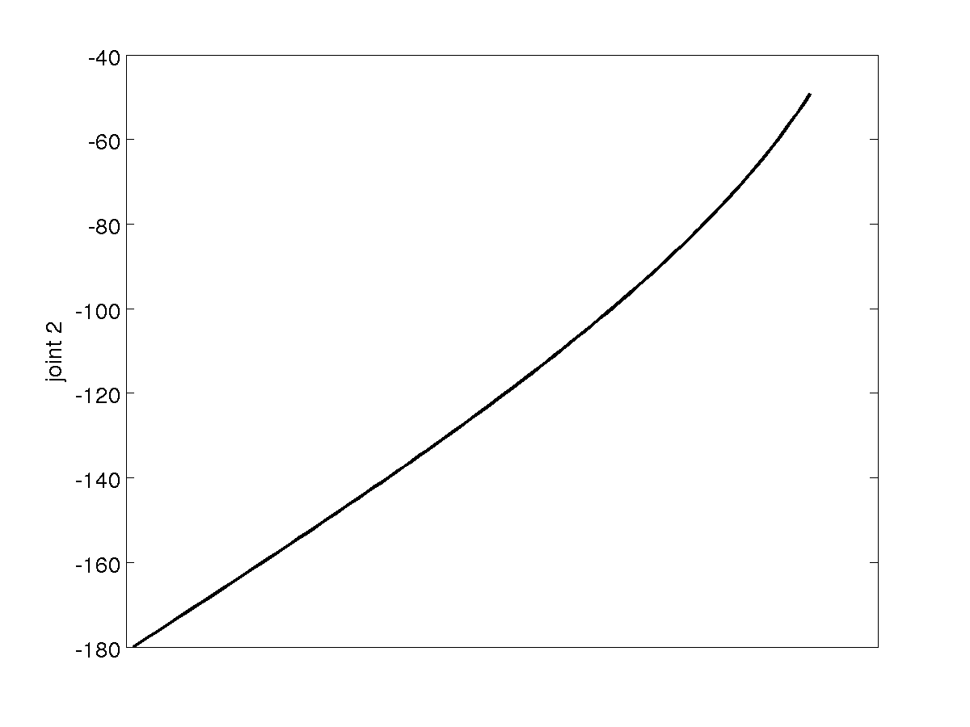
Cartesian-Space Path Joint Variable 2
non-linear joint-space path

Slide 22
Cartesian-Space Straight Line Path
given the current end-effector pose and the desired final end-effector position find a sequence of joint angles that generates the straight line path between the two points
idea
interpolate the between the current and final positions
solve for the inverse kinematics at the interpolated positions to get the joint angles for the interpolated positions

Slide 23
Cartesian-Space Straight Line Path
Δ t = 1 / m where m is the number of steps in the path
Δp = ^{f}p – ⁰p
for j = 1 to m
t_{j} = j Δ t
^{j}p = ⁰p + t_{j} Δ p
find ^{j}Q from ^{f}p (inverse kinematics)
set joints to ^{j}Q
end

Slide 24
Cartesian-Space Path
the previous straight line path algorithm only considered the position of the end effector
why?
what problem do you need to solve if you need to consider the pose of the end effector?

